Slide 1
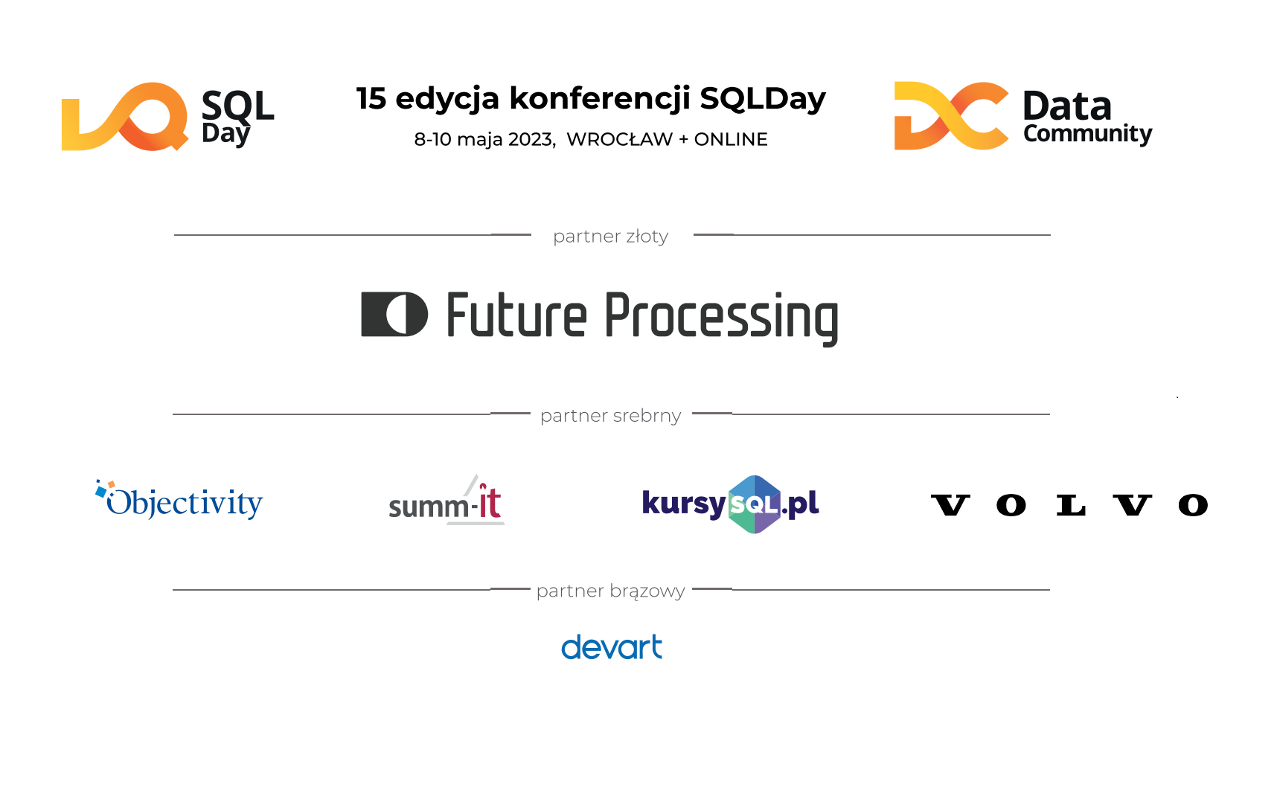

Slide 2
Marcin Szeliga
Medical Image Analysis with Azure Machine Learning Services – case study

Slide 3
Agenda
Team Data Science Process
Project goals and challenges
Environment
Tasks and Techniques
Transfer Learning for Image Classification
Automated Machine Learning for Object Detection
Wrap up

Slide 4


Slide 5
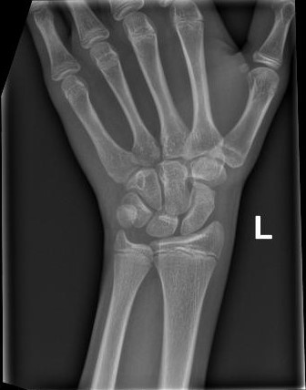
Project goals
Demonstration of the achievements of Artificial Intelligence in medical care by solving practical problems
Scaphoid fracture detection
A scaphoid fracture is usually diagnosed by an X-ray of the wrist
However, occult fractures may be difficult to detect

Slide 6
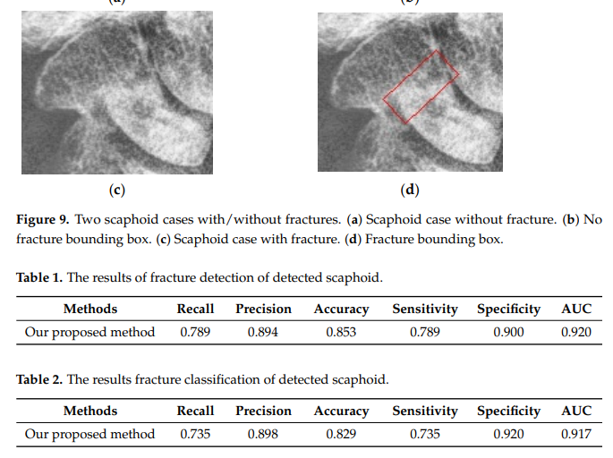
Project challenges
Data collection
Data security and privacy
Data Preparation
Compute resources
Business Value

Slide 7

Environment
Azure Machine Learning Service
Set of Azure Cloud Services
Python & R SDK
That enables you to:
Prepare Data
Build Models
Train Models
Manage Models
Track Experiments
Deploy Models

Slide 8
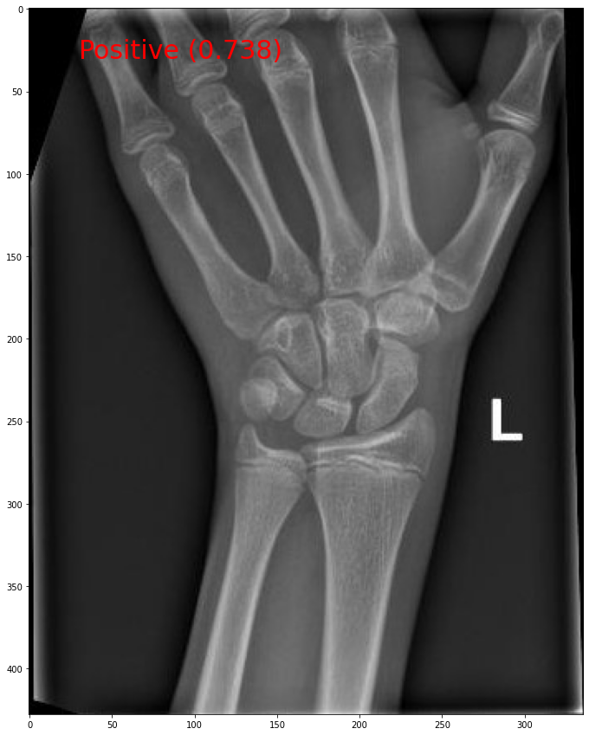
Image Classification
Image Classification is a fundamental task that attempts to comprehend an entire image as a whole
The goal is to classify the image by assigning it to a specific label
Typically, Image Classification refers to images in which only one object appears and is analyzed

Slide 9
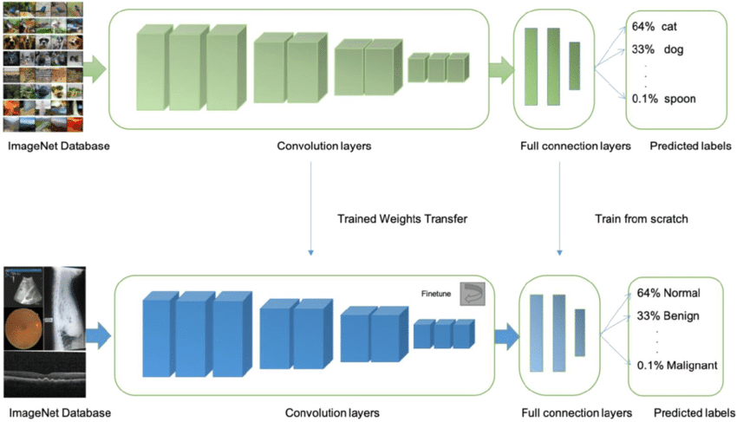
Transfer Learning
Source https://dev.to/amananandrai/pretrained-models-for-transfer-learning-in-keras-for-computer-vision-5eei

Slide 10
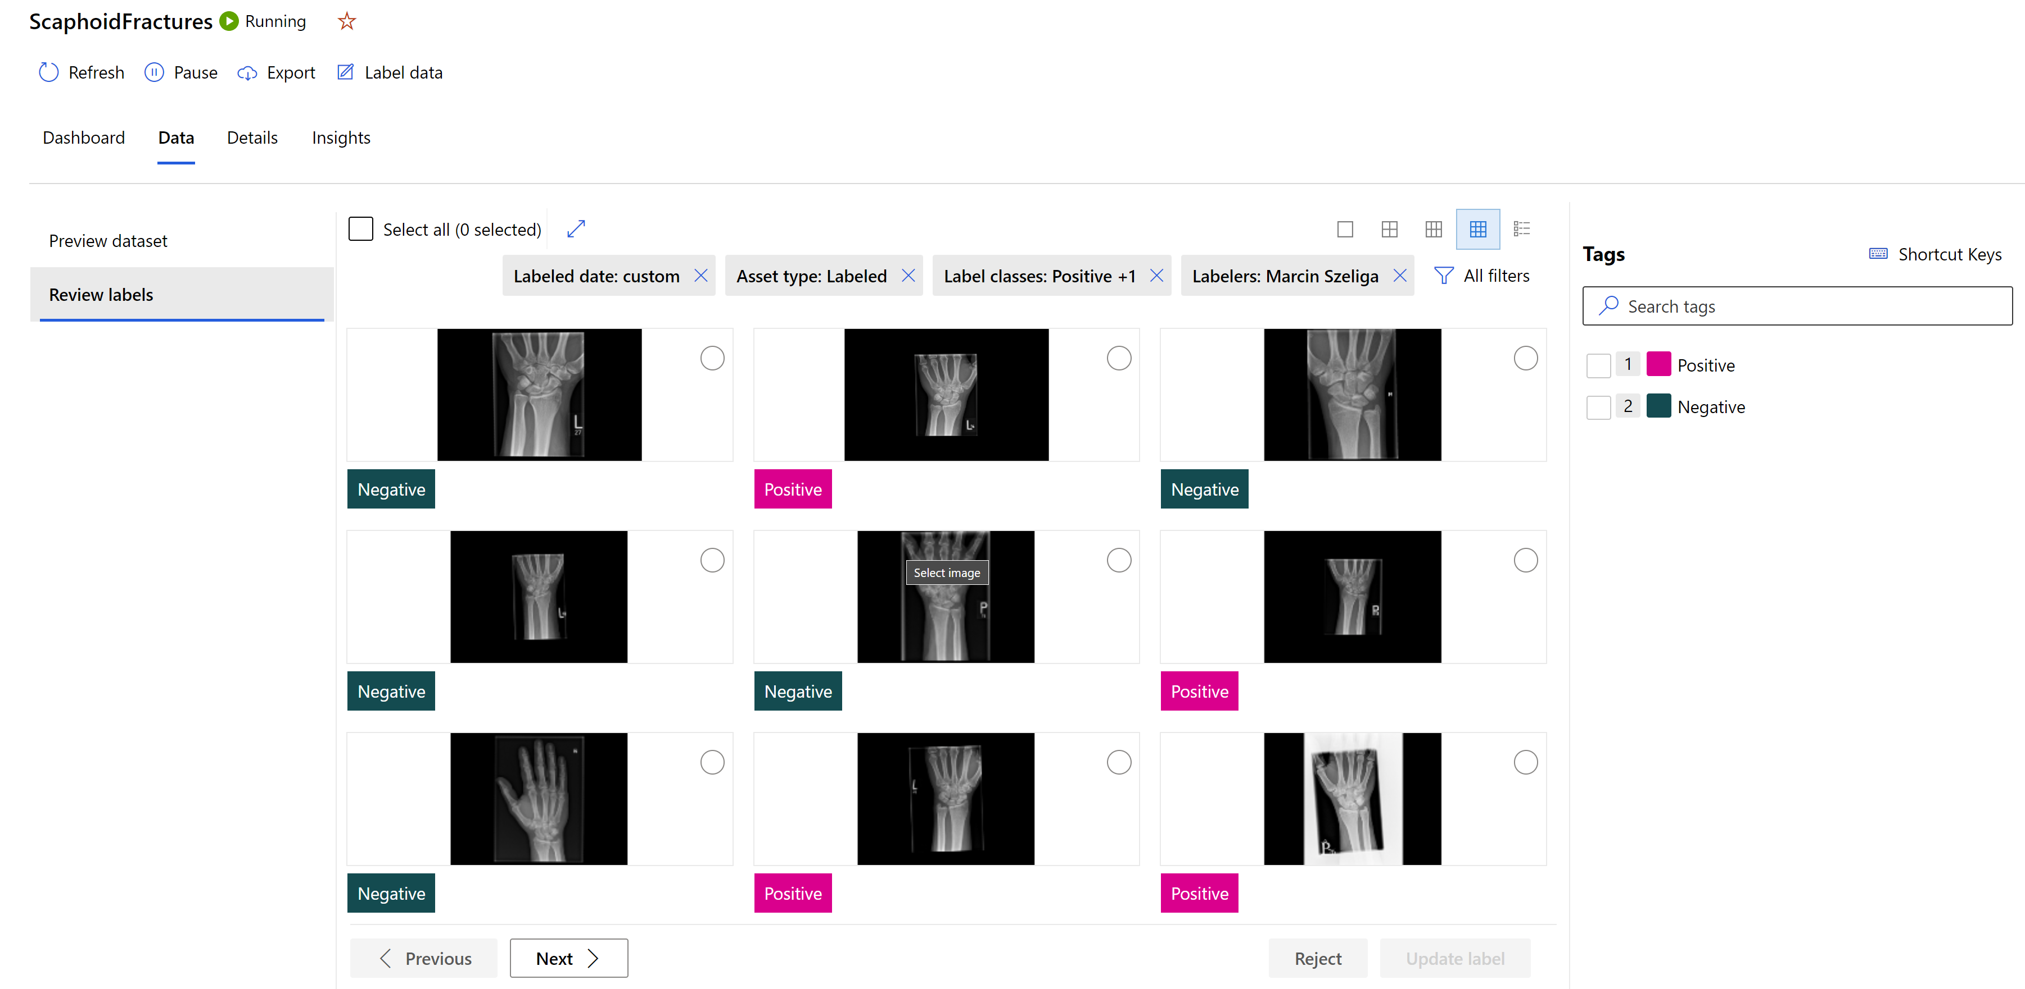
Image Classification: Data Labelling

Slide 11
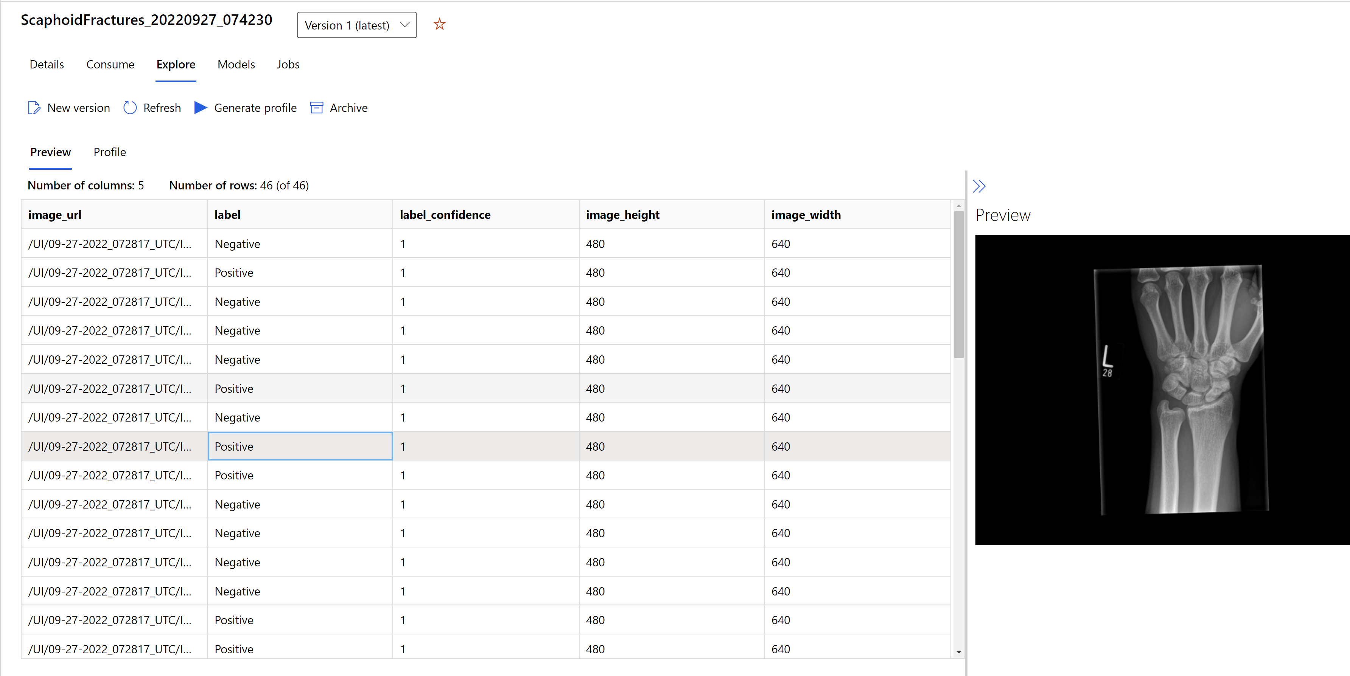
Image Classification: Dataset

Slide 12
Image Classification: Modeling
Data augmentation
Random resize and crop
Horizontal flip
Color jitter (brightness, contrast, saturation, and hue)
Normalization using channel-wise ImageNet’s mean and standard deviation
Base models
MobileNet https://arxiv.org/abs/1704.04861
ResNet https://arxiv.org/abs/1512.03385
ResNeSt https://arxiv.org/abs/2004.08955
SE-ResNeXt50 https://arxiv.org/abs/1709.01507
ViT https://arxiv.org/abs/1706.03762

Slide 13
Image Classification: Modeling
Sampling methods
Currently, only grid and random sampling supports conditional hyperparameter spaces
Early termination policies
Bandit policy
Median stopping policy
Truncation selection policy

Slide 14
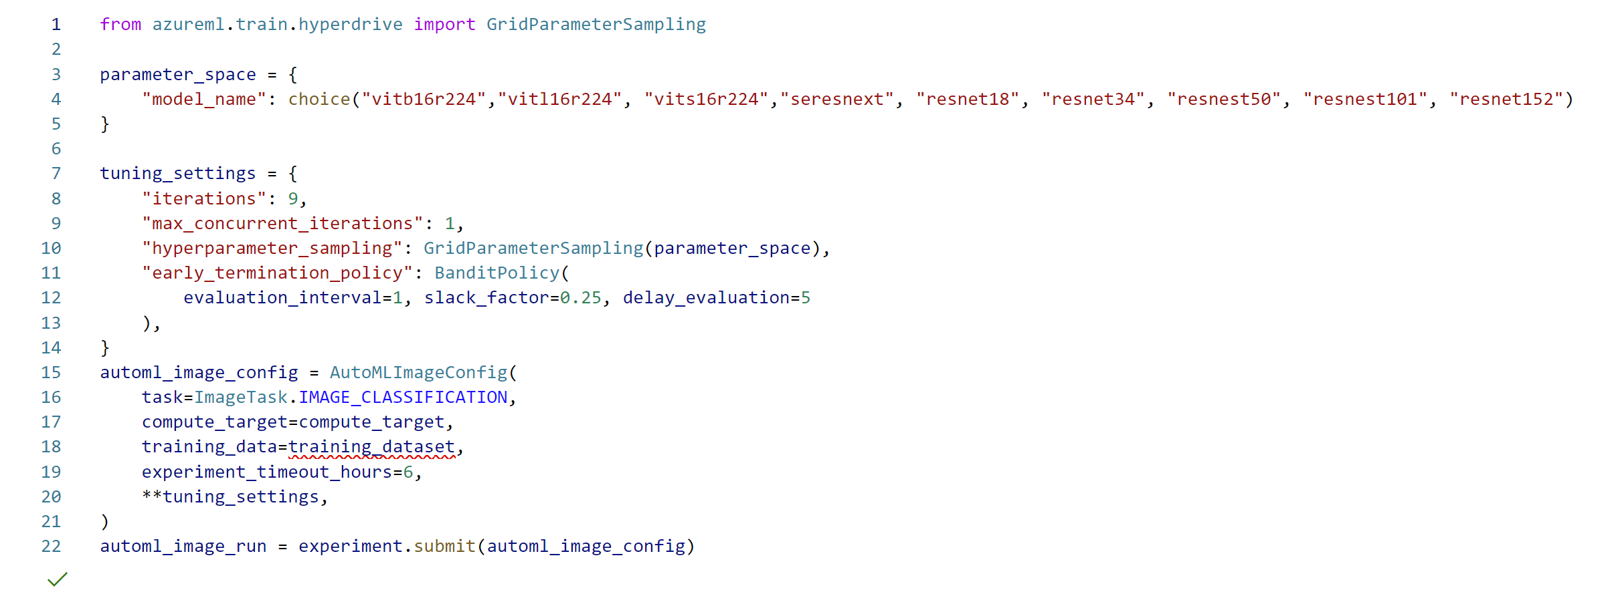
Image Classification: Modeling

Slide 15
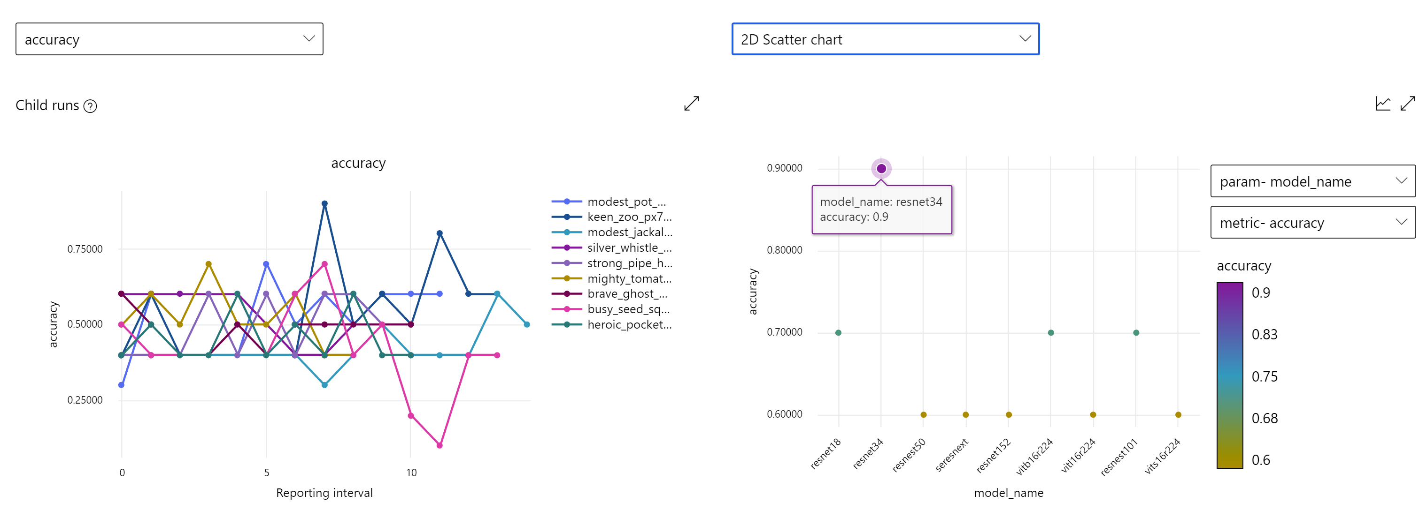
Image Classification: Modeling

Slide 16
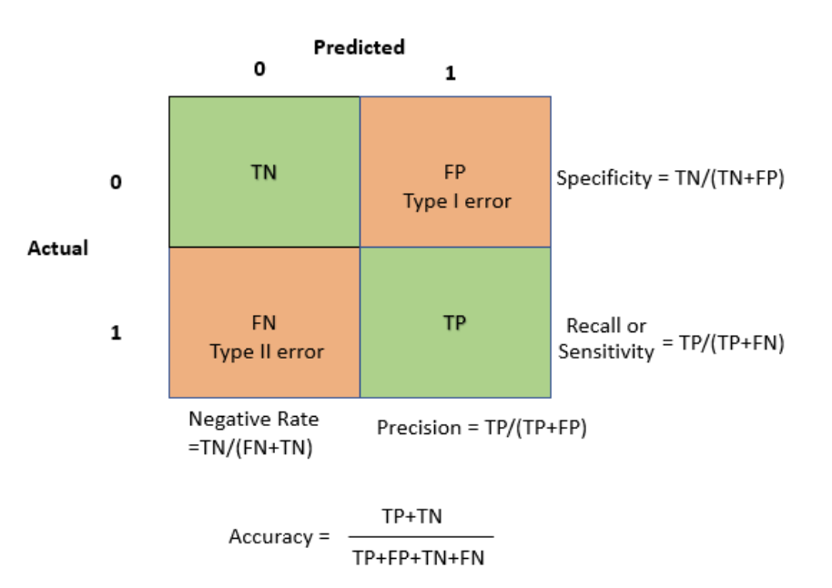
Image Classification: Model evaluation

Slide 17
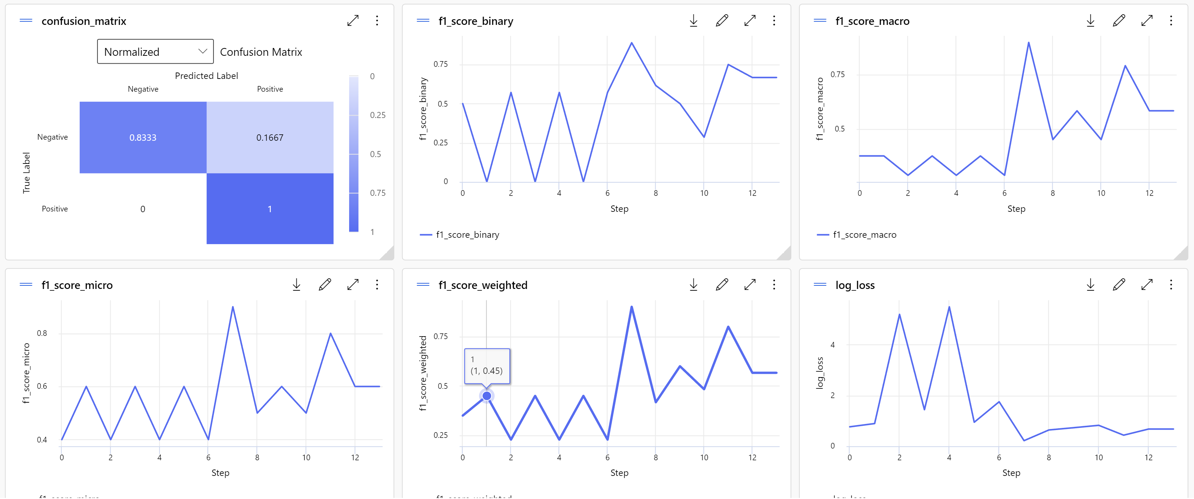
Image Classification: Model evaluation

Slide 18
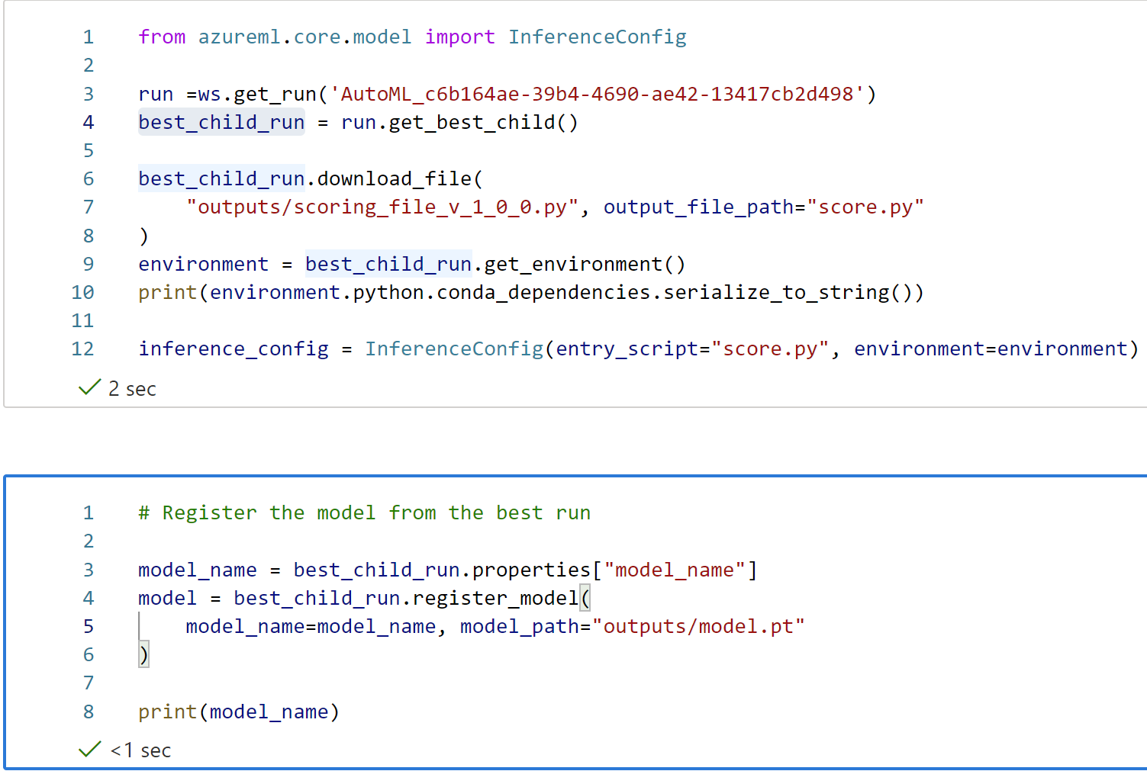
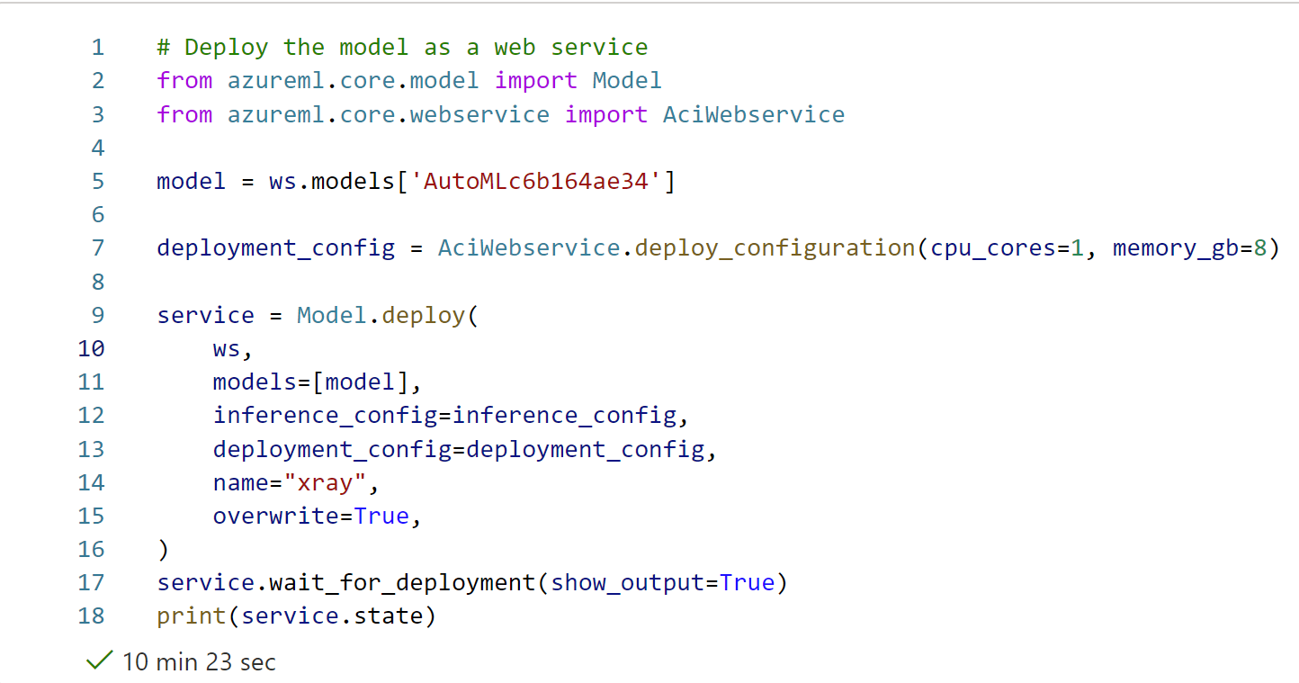
Image Classification: Model deployment

Slide 19
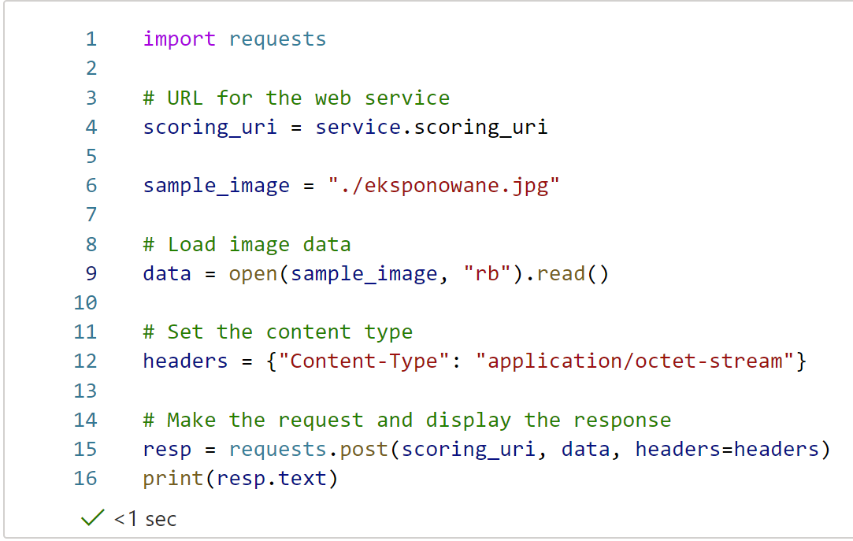
Image Classification: Inferencing

Slide 20
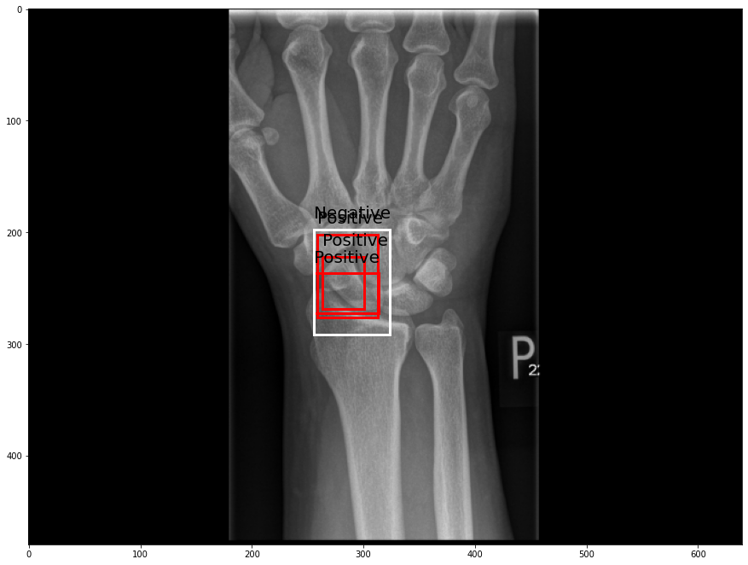
Object Detection
Object detection is the task of detecting instances of objects of a certain class within an image
Involves both classification and localization tasks
Two methods:
One-stage methods prioritize inference speed
Example models include YOLO and RetinaNet
Two-stage methods prioritize detection accuracy
Example models include Faster R-CNN

Slide 21
Automated Machine Learning
Which features?
Which algorithm?
Which hyperparameters?
Mileage
Condition
Car brand
Year of make
Regulations
…
Gradient Boosted
Nearest Neighbors
SVM
Bayesian Regression
LGBM
…
Parameter 1
Parameter 2
Parameter 3
Parameter 4
…
Mileage
Gradient Boosted
Criterion
Loss
Min Samples Split
Min Samples Leaf
Others
Car brand
Year of make
30%
Model

Slide 22
Automated Machine Learning
Which features?
Which algorithm?
Which hyperparameters?
Mileage
Condition
Car brand
Year of make
Regulations
…
Gradient Boosted
Nearest Neighbors
SVM
Bayesian Regression
LGBM
…
Criterion
Loss
Min Samples Split
Min Samples Leaf
Others
Mileage
Gradient Boosted
N Neighbors
Weights
Metric
P
Others
Condition
Nearest Neighbors
Car brand
Car brand
50%
Year of make
30%
Year of make
Model
Iterate

Slide 23
Automated Machine Learning
Which features?
Which algorithm?
Which hyperparameters?
30%
Mileage
Gradient Boosted
Condition
Nearest Neighbors
Car brand
SVM
50%
70%
30%
45%
50%
65%
95%
35%
10%
75%
20%
70%
30%
Year of make
LGBM
15%
Regulations
Bayesian Regression

Slide 24
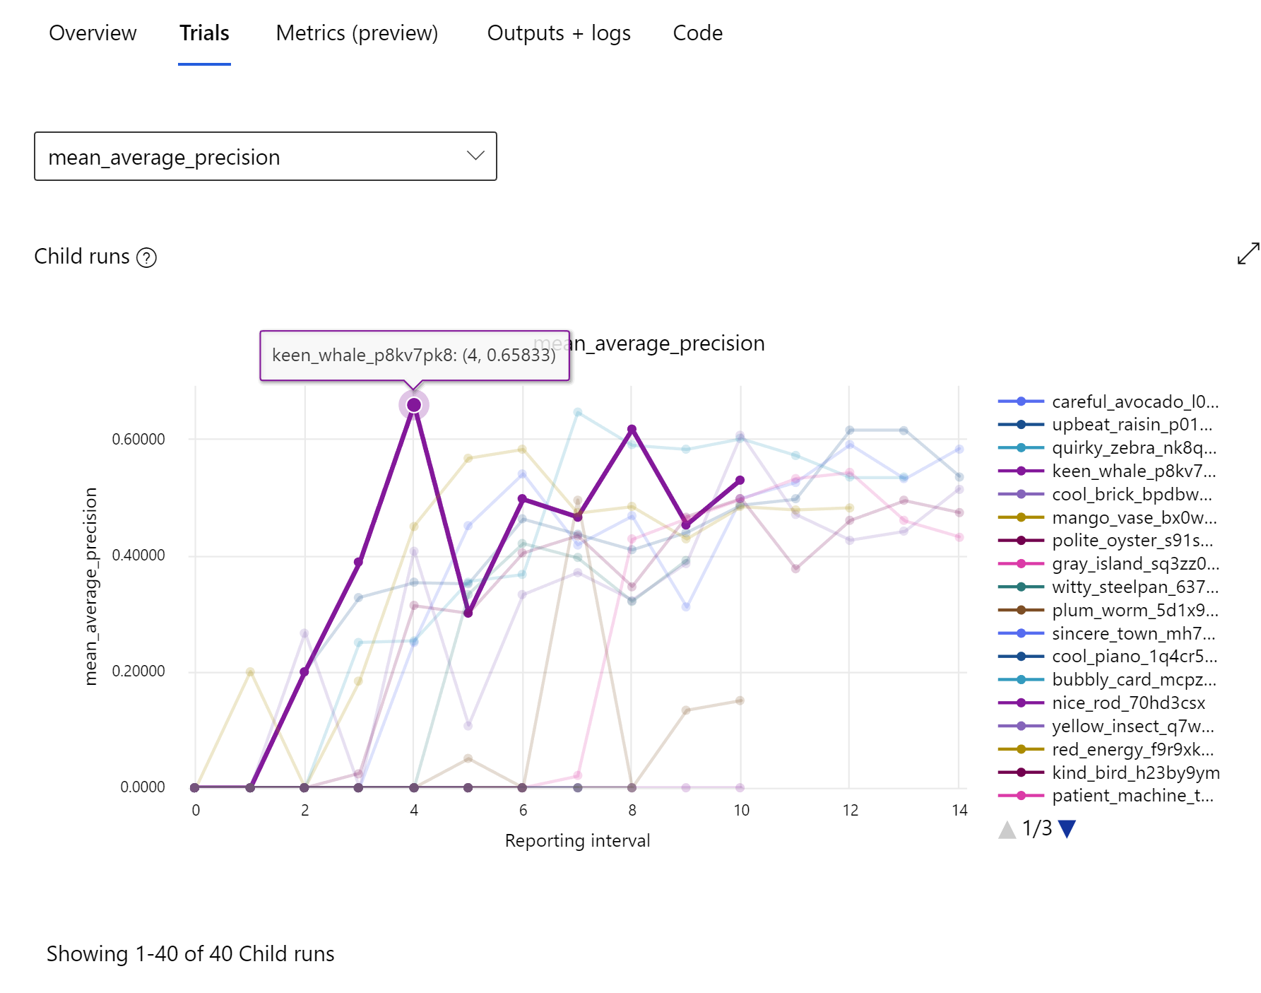
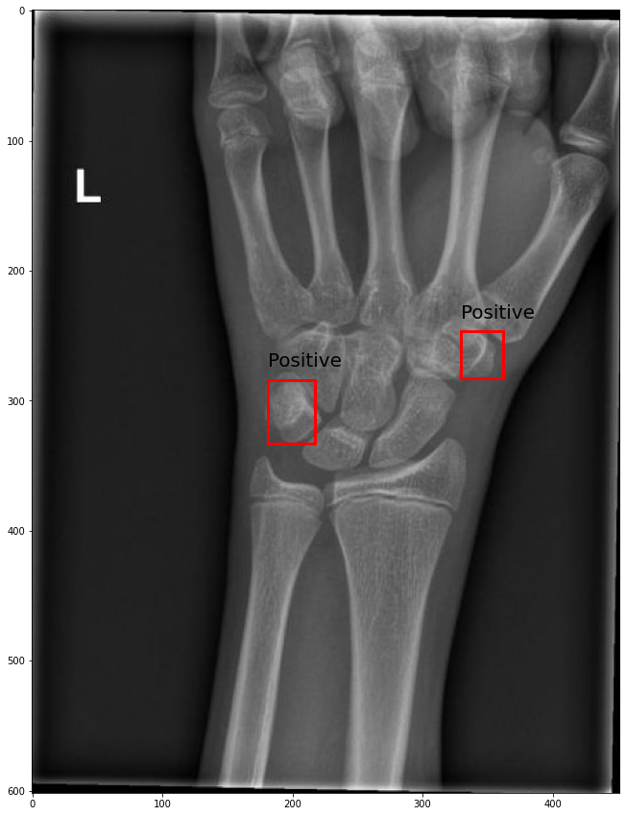
Object Detection: First result

Slide 25
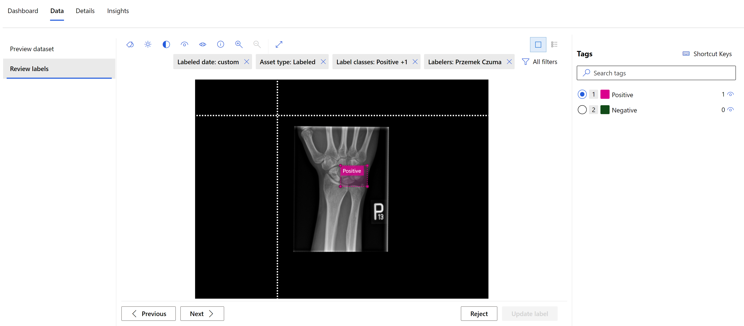
Object Detection: Data Labelling

Slide 26
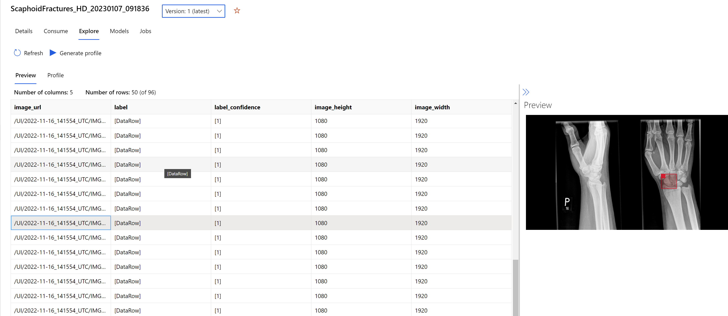
Object Detection: Dataset

Slide 27
Object Detection: Modeling
Data augmentation
Random crop around bounding boxes
Expand
Horizontal flip
Normalization
Resize
Base models
YOLOv5 https://arxiv.org/abs/1506.02640
Faster RCNN ResNet FPN https://arxiv.org/abs/1506.01497
RetinaNet ResNet FPN https://arxiv.org/abs/1708.02002

Slide 28
Object Detection: Modeling
Hyperparameters optimization
number_of_epochs
learning_rate
training_batch_size
optimizer
momentum
Nesterov
layers_to_freeze
Early termination policies
Bandit policy
Median stopping policy
Truncation selection policy

Slide 29
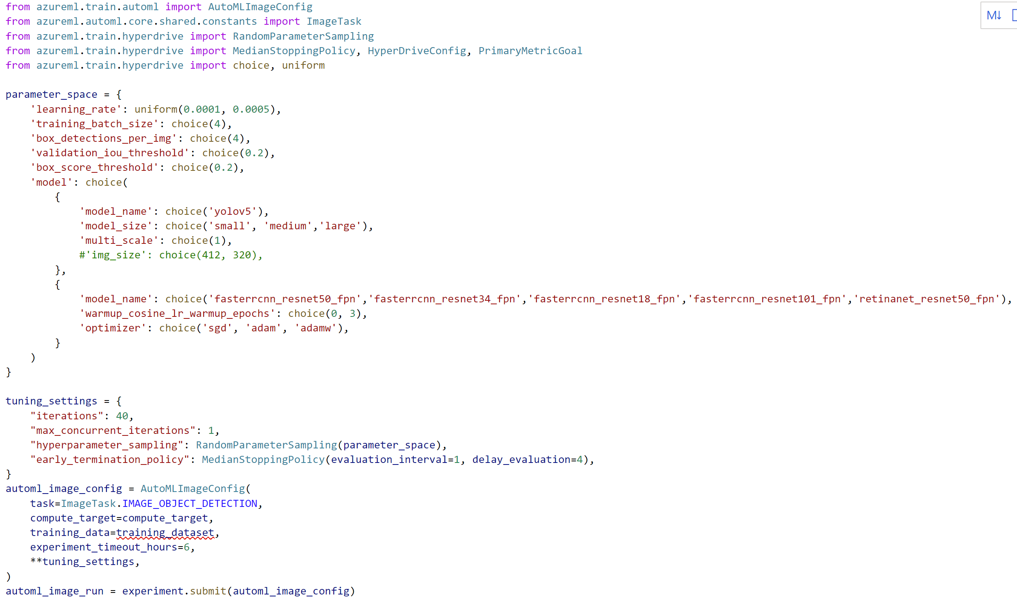
Object Detection: Modeling

Slide 30
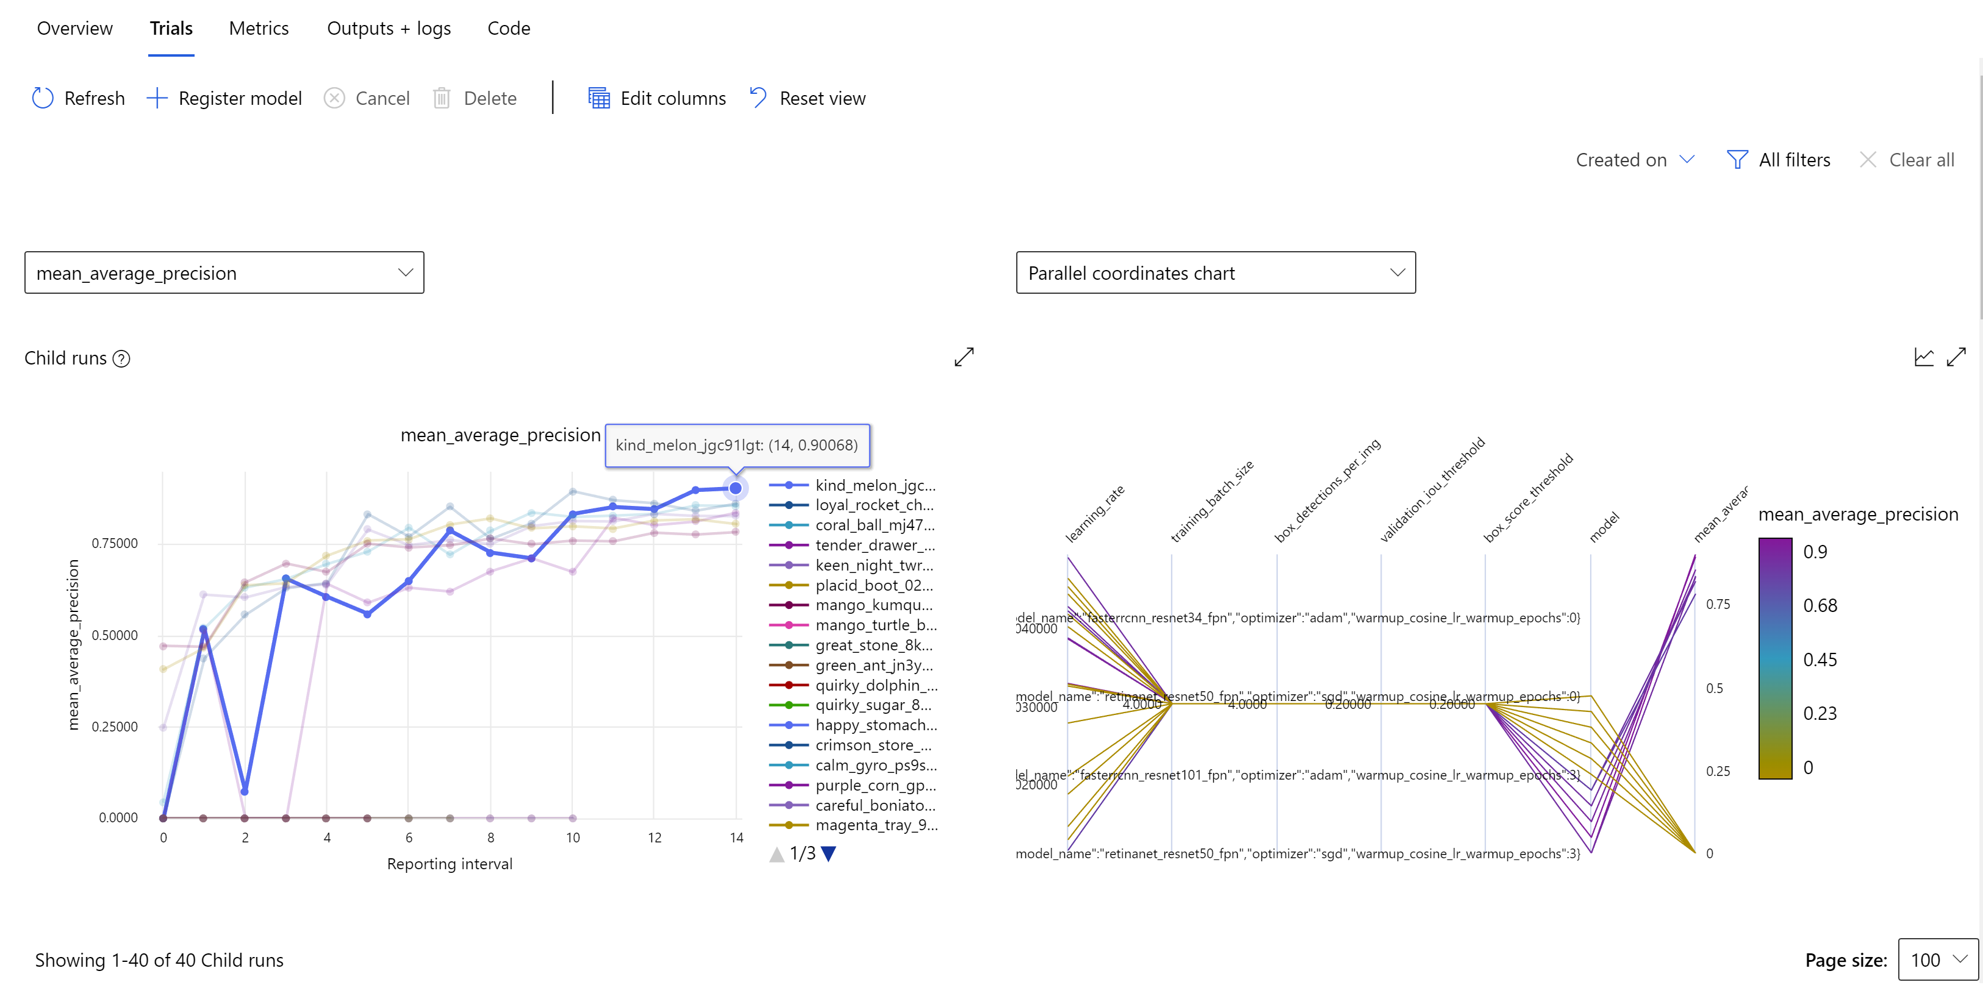
Object Detection: Modeling

Slide 31
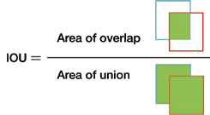
Object Detection: Model evaluation

Slide 32
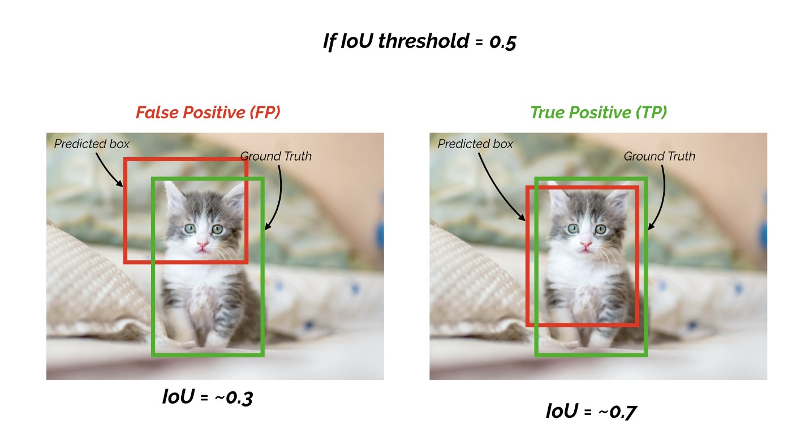
Object Detection: Model evaluation
mAP score is calculated by taking the mean AP over all classes and/or overall IoU thresholds

Slide 33
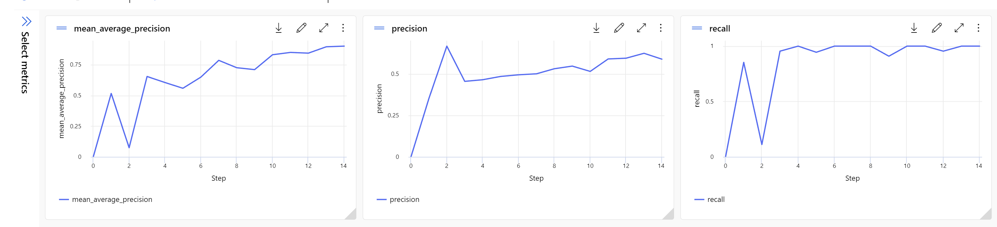
Object Detection: Model evaluation

Slide 34
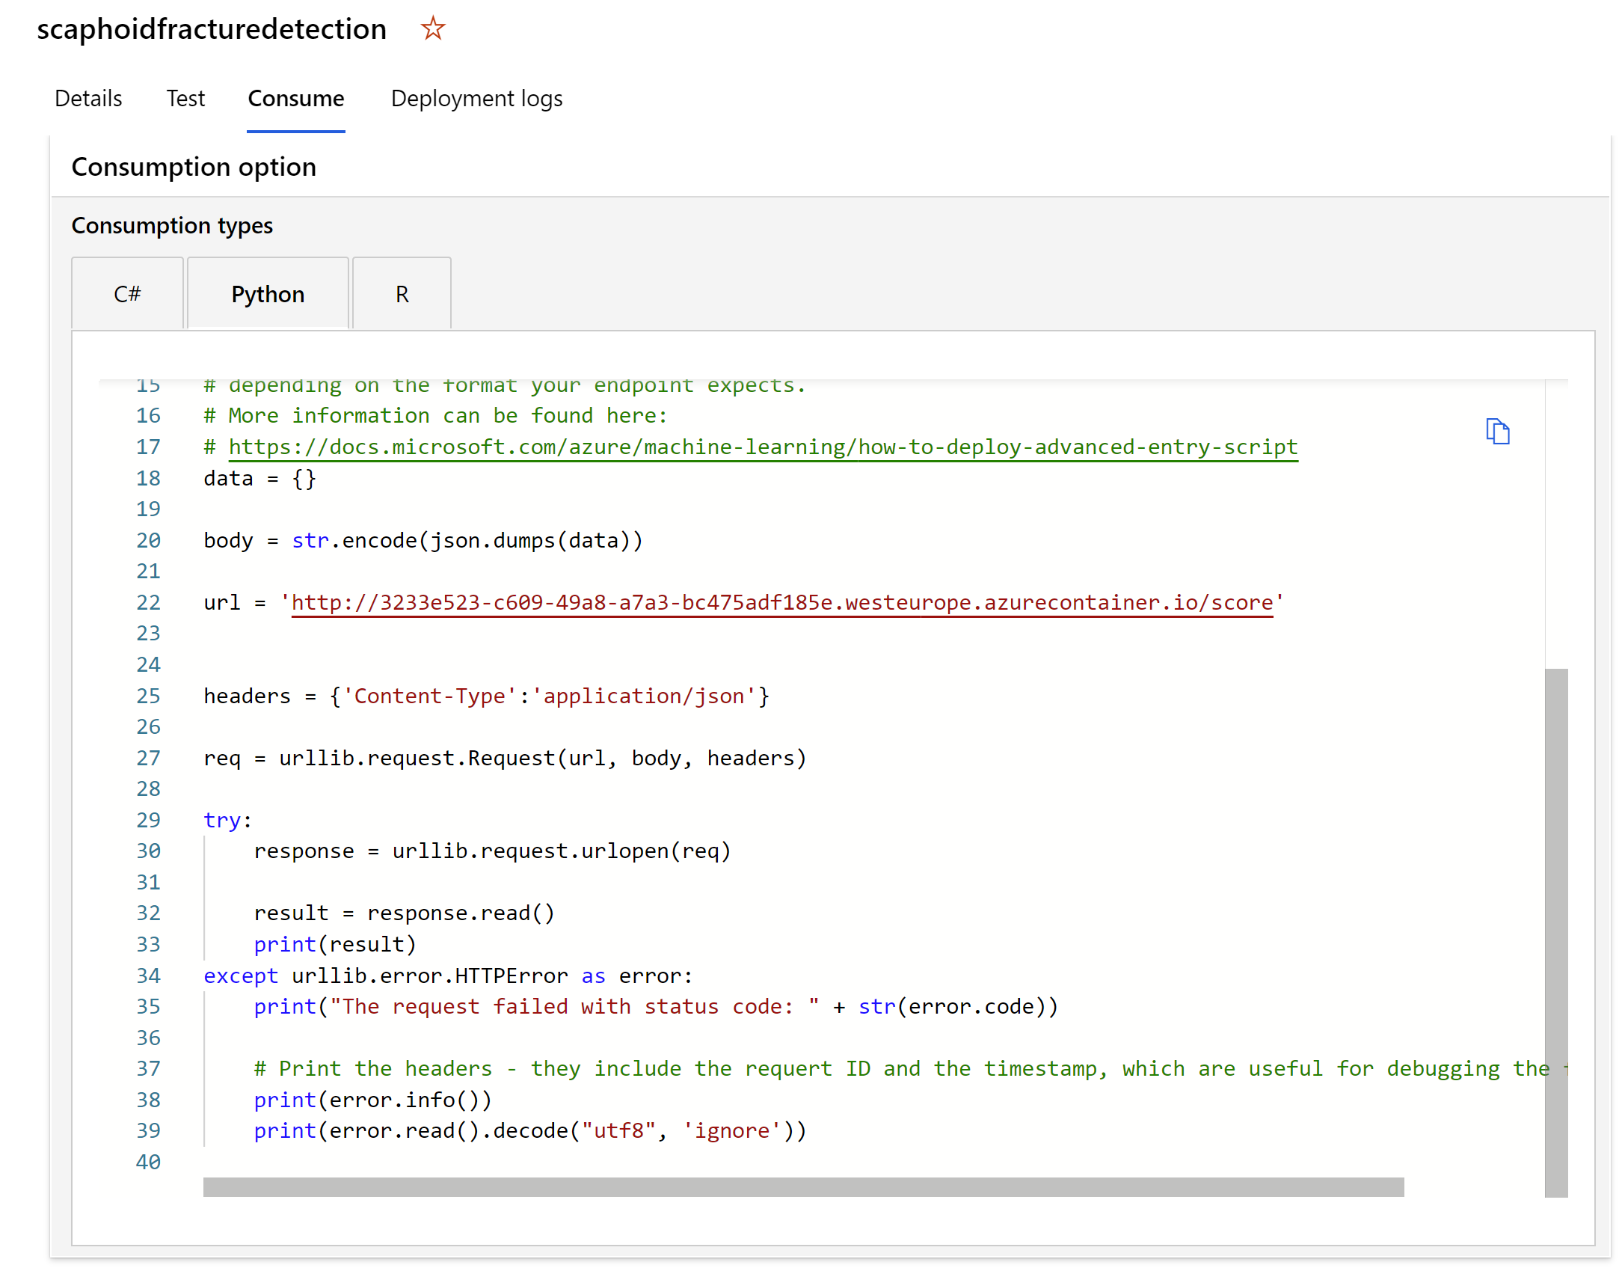
Object Detection: Model deployment

Slide 35
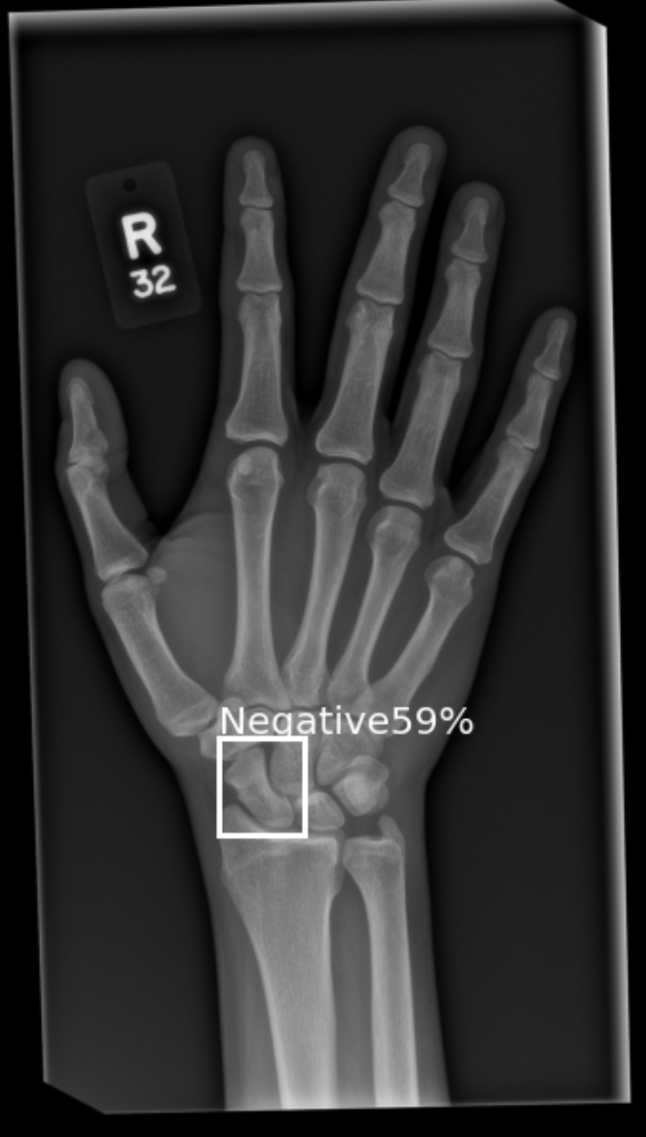
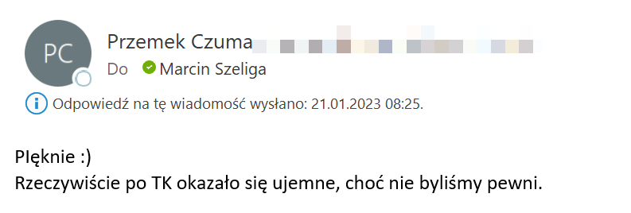
Object Detection: Inferencing

Slide 36
Wrap up
Medical Image Analysis can be automated, significantly reducing the time and cost of experiments and increasing their chances of success
The combination of automatic machine learning with knowledge transfer techniques allows Data Scientists to focus on the problem being solved as well as assess and improve data quality, removing from them the burden of implementing the learning procedure and evaluating candidate models

